Slide 1

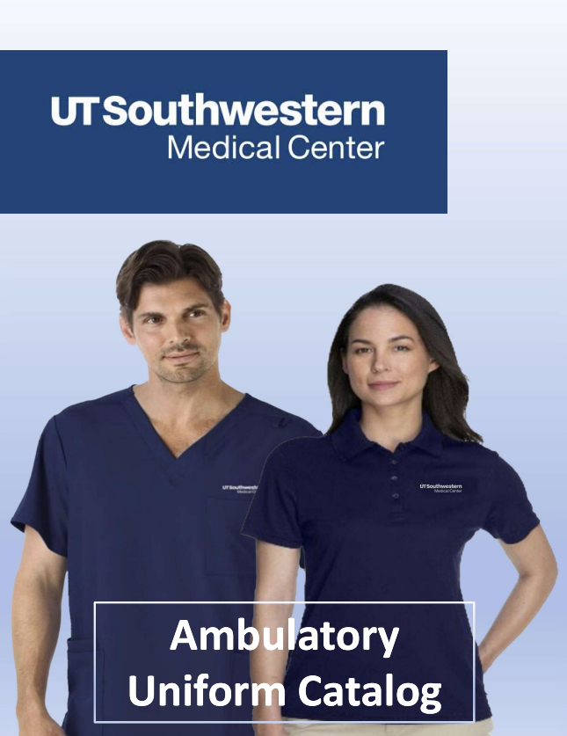
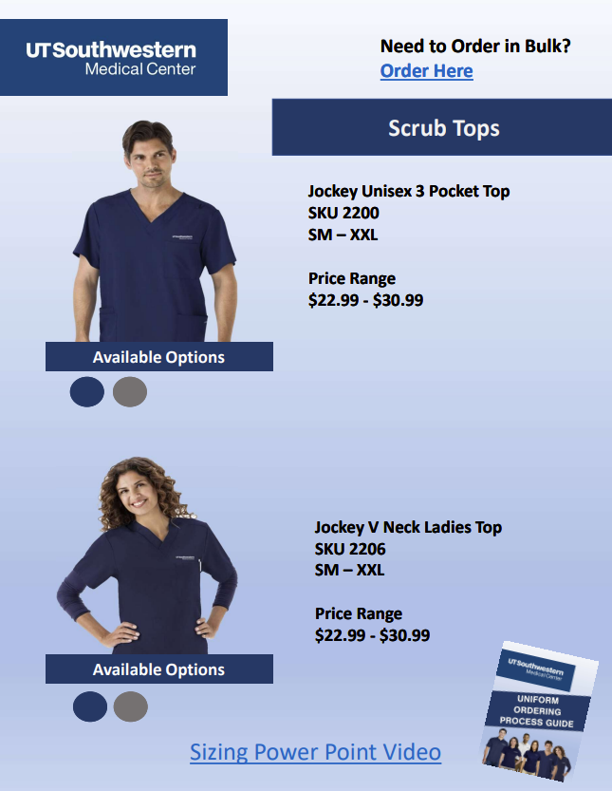
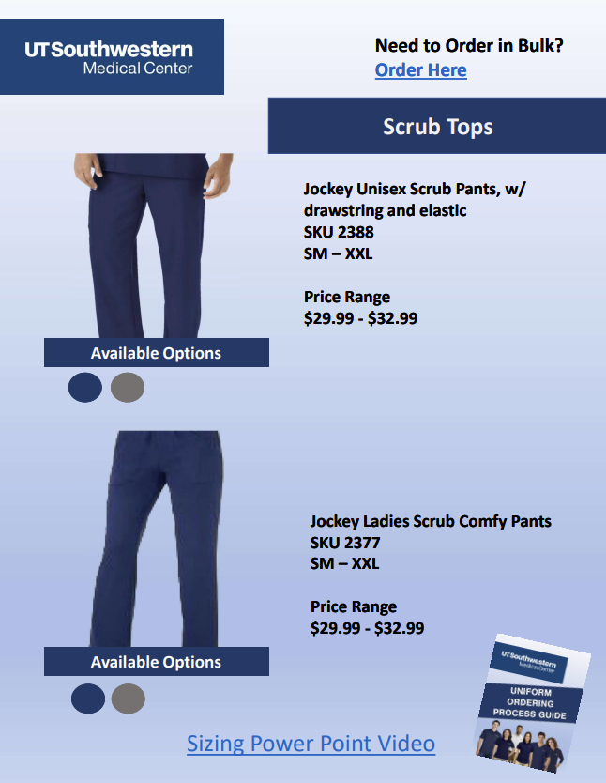
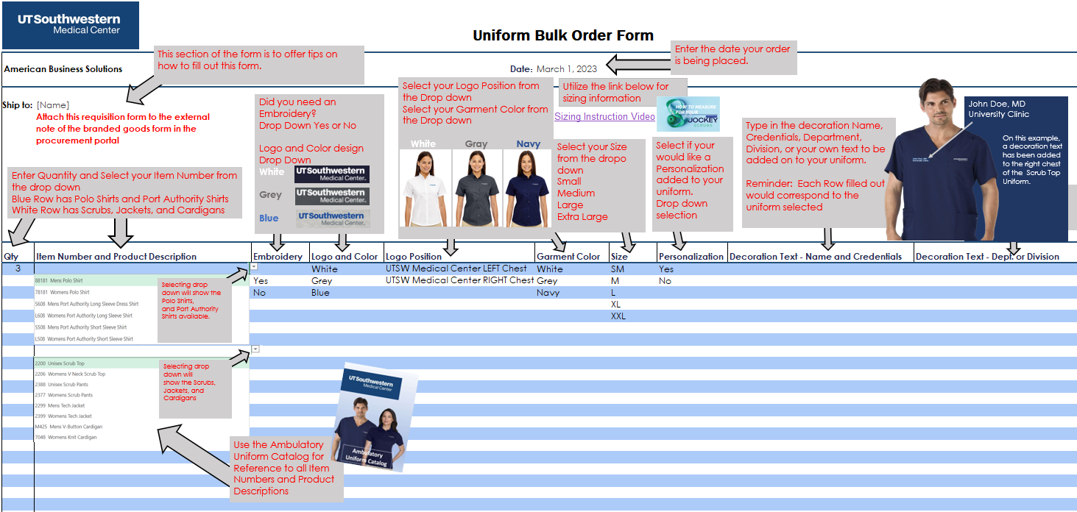
UNIFORM ORDERING PROCESS
Need to Order in Bulk?
Order Here
Step 1: Select Uniforms from the Ambulatory Uniform Catalog
• Using the catalog, decide which uniforms you need
• Determine quantity, size, color and styles
Step 2: Enter information into the Uniform Bulk Order Form (excel spreadsheet)
• Using the provided order form, Follow the form instructions tab, and complete form
NOTE: Attach the requisition form to the external note of the branded goods from in the procurement portal.
Sizing Power Point Video

Slide 2
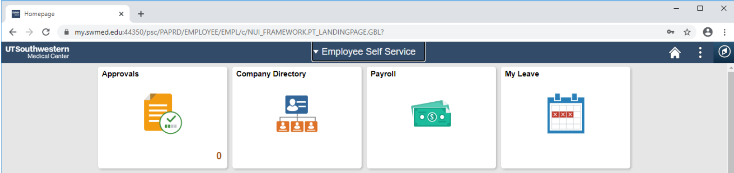
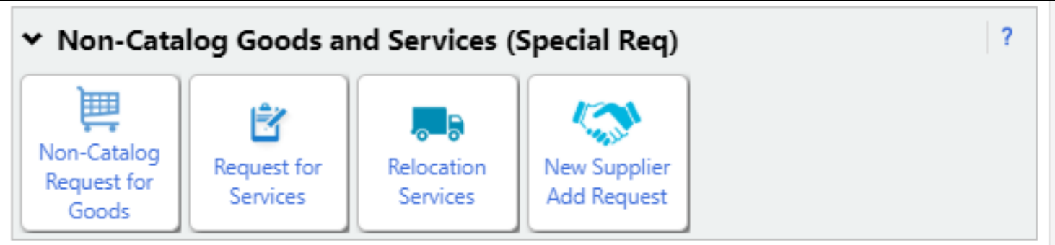
UNIFORM ORDERING PROCESS
Need to Order in Bulk?
Order Here
Step 3: Placing order in UT Southwestern Procurement Portal
• Log onto UT Southwestern site through a supported browser
• In the upper right corner choose MY UTSW (this will require your UTSW log in and password)
• In the Quick Links section to the right, choose People Soft (this may prompt you to log in again)
• Select the diamond icon to the far right, this is the navbar
• Opening the navbar link, choose Procurement Portal (again this will prompt you for your UTSW login and password)
Step 4: Submit UTSW Procurement Portal Requisition
• Create a UTSW Procurement Portal requisition using the Non-Catalog Request for Goods (Special Req) tile.
Sizing Power Point Video

Slide 3
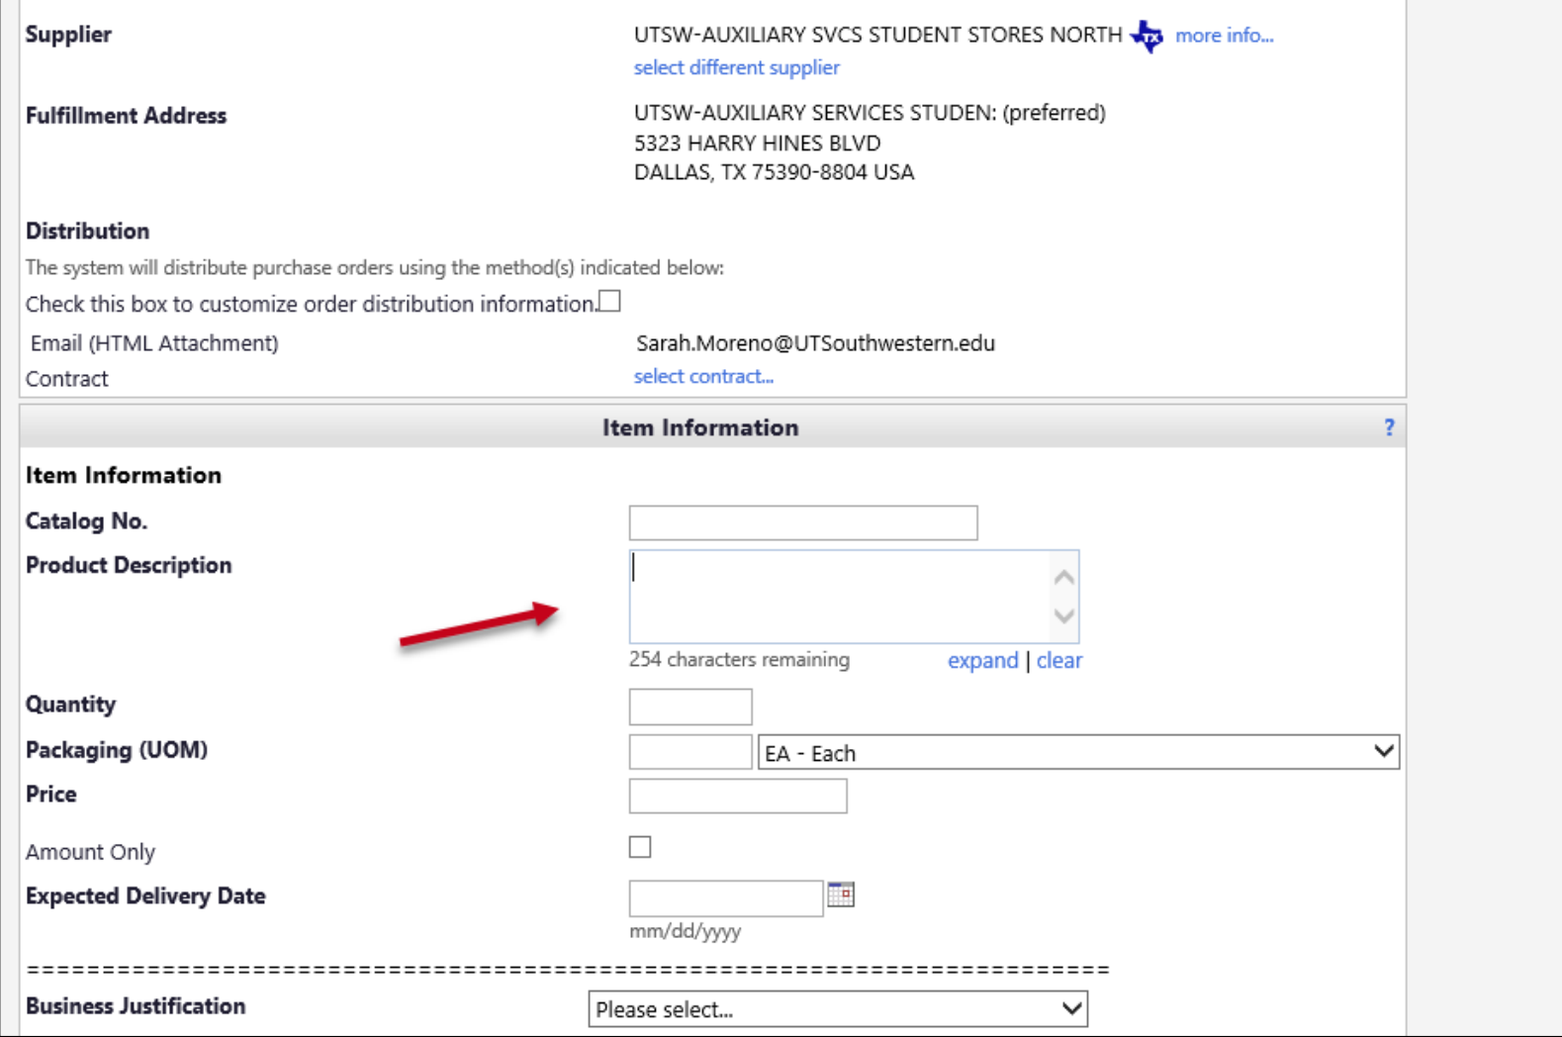
Uniform Ordering Process
Need to Order in Bulk?
Order Here
UNIFORM ORDERING PROCESS
• Fill out ALL required fields
• It is very important that you select the Supplier UTSW-AUXILIARY SVCS STUDENT
STORES NORTH or UTSW-AUXILIARY SVCS STUDENT STORES SOUTH
• Helpful Commodity Codes:
Class 53101800 Coats and jackets
Class 53102700 Uniforms
Class 53103000 T-shirts
Commodity 53101602 Men’s shirts
Commodity 78121603 Freight fee
Class 78121600 Material handling services
Link to how to use Commodity Codes
• Business Justification - ITEM NOT IN PUNCH OUT or CATALOG
Sizing Power Point Video

Slide 4
UNIFORM ORDERING PROCESS
Need to Order in Bulk?
Order Here
• Red Arrow Denotes: Please note product descriptions for clarity for approvers. Once all
fields required are completed, submit the requisition.
• The requisition will be sent to APPROVERS, and finally UNIVERSITY STORES for approval
• Once Final approval is given, a Purchase Order number will be issued for this requisition
• The order will be placed, using that specific purchase order
Step 5: Receiving of goods
• You will be notified via email for your in-store pickup or drop shipment delivery date by
UniversityStore@mednet.swmed.edu
Sizing Power Point Video

